Slide 1
Trees
Chapter 8

Slide 2
Chapter Objectives
To learn how to use a tree to represent a hierarchical organization of information
To learn how to use recursion to process trees
To understand the different ways of traversing a tree
To understand the differences between binary trees, binary search trees, and heaps
To learn how to implement binary trees, binary search trees, and heaps using linked data structures and arrays

Slide 3
Chapter Objectives (cont.)
To learn how to use a binary search tree to store information so that it can be retrieved in an efficient manner
To learn how to use a Huffman tree to encode characters using fewer bits than ASCII or Unicode, resulting in smaller files and reduced storage requirements

Slide 4
Trees - Introduction
All previous data organizations we've studied are linear—each element can have only one predecessor and one successor
Accessing all elements in a linear sequence is O(n)
Trees are nonlinear and hierarchical
Tree nodes can have multiple successors (but only one predecessor)

Slide 5
Trees - Introduction (cont.)
Trees can represent hierarchical organizations of information:
class hierarchy
disk directory and subdirectories
family tree

Slide 6
Trees - Introduction (cont.)
Trees are recursive data structures because they can be defined recursively
Many methods to process trees are written recursively
This chapter focuses on the binary tree
In a binary tree each element has two successors
Binary trees can be represented by arrays and by linked data structures
Searching a binary search tree, generally is more efficient than linearly searching an ordered list—O(log n) versus O(n)

Slide 7
Tree Terminology and Applications
Section 8.1

Slide 8
Tree Terminology
A tree consists of a collection of elements or nodes, with each node linked to its successors
dog
cat
wolf
canine

Slide 9
Tree Terminology (cont.)
A tree consists of a collection of elements or nodes, with each node linked to its successors
The node at the top of a tree is called its root
dog
cat
wolf
canine

Slide 10
Tree Terminology (cont.)
A tree consists of a collection of elements or nodes, with each node linked to its successors
The links from a node to its successors are called branches
dog
cat
wolf
canine

Slide 11
Tree Terminology (cont.)
A tree consists of a collection of elements or nodes, with each node linked to its successors
The successors of a node are called its children
dog
cat
wolf
canine

Slide 12
Tree Terminology (cont.)
A tree consists of a collection of elements or nodes, with each node linked to its successors
dog
The predecessor of a node is called its parent
cat
wolf
canine

Slide 13
Tree Terminology (cont.)
A tree consists of a collection of elements or nodes, with each node linked to its successors
Each node in a tree has exactly one parent except for the root node, which has no parent
dog
cat
wolf
canine

Slide 14
Tree Terminology (cont.)
A tree consists of a collection of elements or nodes, with each node linked to its successors
Nodes that have the same parent are siblings
dog
cat
wolf
canine

Slide 15
Tree Terminology (cont.)
A tree consists of a collection of elements or nodes, with each node linked to its successors
A node that has no children is called a leaf node
dog
cat
wolf
canine

Slide 16
Tree Terminology (cont.)
A tree consists of a collection of elements or nodes, with each node linked to its successors
Leaf nodes also are known as external nodes, and nonleaf nodes are known as internal nodes
A node that has no children is called a leaf node
dog
cat
wolf
canine

Slide 17
Tree Terminology (cont.)
A tree consists of a collection of elements or nodes, with each node linked to its successors
dog
cat
wolf
canine
A generalization of the parent-child relationship is the ancestor-descendant relationship

Slide 18
Tree Terminology (cont.)
A tree consists of a collection of elements or nodes, with each node linked to its successors
dog is the parent of cat in this tree
dog
cat
wolf
canine
A generalization of the parent-child relationship is the ancestor-descendant relationship

Slide 19
Tree Terminology (cont.)
A tree consists of a collection of elements or nodes, with each node linked to its successors
cat is the parent of canine in this tree
dog
cat
wolf
canine
A generalization of the parent-child relationship is the ancestor-descendant relationship

Slide 20
Tree Terminology (cont.)
A tree consists of a collection of elements or nodes, with each node linked to its successors
dog
canine is a descendant of cat in this tree
cat
wolf
canine
A generalization of the parent-child relationship is the ancestor-descendant relationship

Slide 21
Tree Terminology (cont.)
A tree consists of a collection of elements or nodes, with each node linked to its successors
dog is an ancestor of canine in this tree
dog
cat
wolf
canine
A generalization of the parent-child relationship is the ancestor-descendant relationship

Slide 22
Tree Terminology (cont.)
A tree consists of a collection of elements or nodes, with each node linked to its successors
dog
cat
wolf
canine
A subtree of a node is a tree whose root is a child of that node

Slide 23
Tree Terminology (cont.)
A tree consists of a collection of elements or nodes, with each node linked to its successors
dog
cat
wolf
canine
A subtree of a node is a tree whose root is a child of that node

Slide 24
Tree Terminology (cont.)
A tree consists of a collection of elements or nodes, with each node linked to its successors
dog
cat
wolf
canine
A subtree of a node is a tree whose root is a child of that node

Slide 25
Tree Terminology (cont.)
A tree consists of a collection of elements or nodes, with each node linked to its successors
The level of a node is determined by its distance from the root
dog
cat
wolf
canine

Slide 26
Tree Terminology (cont.)
A tree consists of a collection of elements or nodes, with each node linked to its successors
The level of a node is its distance from the root plus 1
Level 1
dog
Level 2
cat
wolf
Level 3
canine

Slide 27
Tree Terminology (cont.)
A tree consists of a collection of elements or nodes, with each node linked to its successors
Level 1
dog
The level of a node is defined recursively
Level 2
cat
wolf
Level 3
canine

Slide 28
Tree Terminology (cont.)
A tree consists of a collection of elements or nodes, with each node linked to its successors
Level 1
dog
The level of a node is defined recursively
Level 2
cat
wolf
Level 3
canine
If node n is the root of tree T, its level is 1
If node n is not the root of tree T, its level is 1 + the level of its parent

Slide 29
Tree Terminology (cont.)
A tree consists of a collection of elements or nodes, with each node linked to its successors
The height of a tree is the number of nodes in the longest path from the root node to a leaf node
dog
cat
wolf
canine

Slide 30
Tree Terminology (cont.)
A tree consists of a collection of elements or nodes, with each node linked to its successors
The height of a tree is the number of nodes in the longest path from the root node to a leaf node
dog
The height of this tree is 3
cat
wolf
canine

Slide 31
Binary Trees
In a binary tree, each node has two subtrees
A set of nodes T is a binary tree if either of the following is true:
T is empty
If T is not empty, it has a root node r with 0, 1, or 2 nonempty binary subtrees whose roots are connected to r by a branch
(T_{L} = left subtree; T_{R} = right subtree)

Slide 32
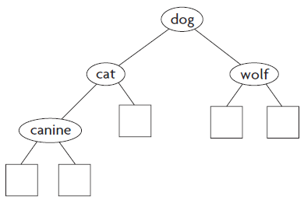
Binary Trees (cont.)
T_{L} , T_{R}, or both can be empty trees
From now on, we will consistently use a NULL pointer to represent an empty subtree

Slide 33
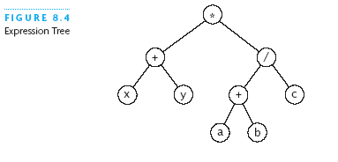
Expression Tree
Each node contains an operator or an operand
Operands are stored in leaf nodes
Parentheses are not stored in the tree because the tree structure dictates the order of operand evaluation
Operators in nodes at higher tree levels are evaluated after operators in nodes at lower tree levels
(x + y) * ((a + b) / c)

Slide 34
Huffman Tree
A Huffman tree represents Huffman codes for characters that might appear in a text file
As opposed to ASCII or Unicode, Huffman code uses different numbers of bits to encode letters; more common characters use fewer bits
Many programs that compress files use Huffman codes

Slide 35
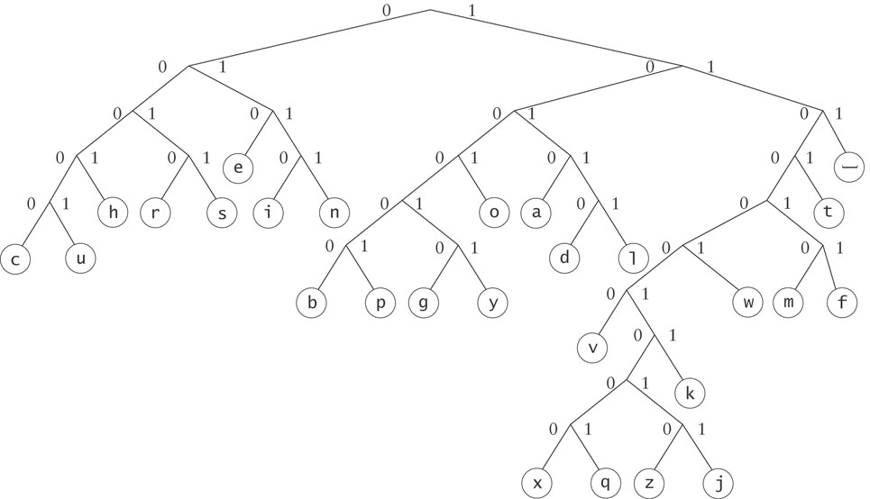
Huffman Tree (cont.)
To form a code, traverse the tree from the root to the chosen character, appending 0 if you branch left, and 1 if you branch right.

Slide 36
Huffman Tree (cont.)
Examples:
d : 10110
e : 010

Slide 37
Binary Search Tree
dog
Binary search trees
All elements in the left subtree precede those in the right subtree
A formal definition:
A set of nodes T is a binary search tree if either of the following is true:
T is empty
If T is not empty, its root node has two subtrees, T_{L} and T_{R}, such that T_{L} and T_{R} are binary search trees and the value in the root node of T is greater than all values in T_{L} and is less than all values in T_{R}
cat
wolf
canine

Slide 38
Recursive Algorithm for Searching a Binary Tree
if the tree is empty
Return null (target is not found) else if the target matches the root node's data
Return the data stored at the root node else if the target is less than the root node's data
Return the result of searching the left subtree of the root else
Return the result of searching the right subtree of the root

Slide 39
Binary Search Tree (cont.)
When searching a BST, a typical probe eliminates half the elements in the tree, so if the tree is relatively balanced, searching can be O(log n)
In the worst case, searching is O(n)

Slide 40
Binary Search Tree (cont.)
The elements in a binary search tree never need to be sorted because they always satisfy the required order relationships
When new elements are inserted (or existing elements are removed) properly, the binary search tree maintains its order
In contrast, a sorted array must be expanded whenever new elements are added, and compacted whenever elements are removed—expanding and contracting are both O(n)

Slide 41
Fullness and Completeness
A full binary tree is a binary tree where all internal nodes have exactly 2 children
Note that the number of leaf nodes is one more than the number of internal nodes
7
1
10
0
3
9
12
2
5
11
13
4
6

Slide 42
Fullness and Completeness (cont.)
A complete binary tree of height h is filled up to depth h – 1 and, at depth h, any unfilled nodes are on the right
A node is filled if it has a value stored in it
7
3
10
1
5
9
11
0
2
4
6
8

Slide 43
Fullness and Completeness (cont.)
More formally, a binary tree of height h is complete if:
All nodes at depth h – 2 and above have two children
When a node at depth h – 1 has children, all nodes to the left of it have two children
If a node at depth h – 1 has one child, it is a left child
7
3
10
1
5
9
11
0
2
4
6
8

Slide 44
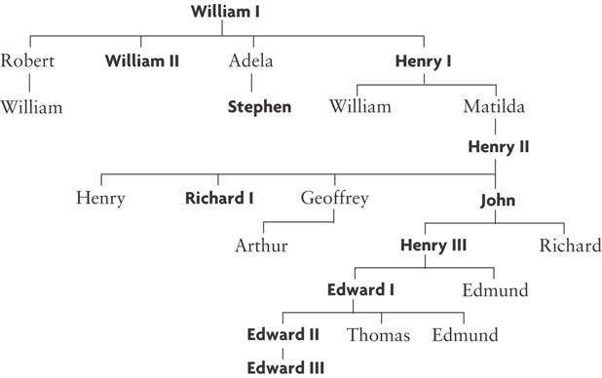
General Trees
We do not explore general trees in this chapter, but nodes of a general tree can have any number of subtrees

Slide 45
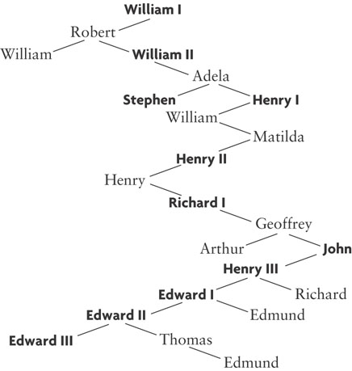
General Trees (cont.)
A general tree can be represented using a binary tree
The left branch of a node is the oldest child, and each right branch is connected to the next younger sibling (if any)

Slide 46
Tree Traversals
Section 8.2

Slide 47
Tree Traversals
Often we want to determine the nodes of a tree and their relationship
We can do this by walking through the tree in a prescribed order and visiting the nodes as they are encountered
This process is called tree traversal
Three common kinds of tree traversal
Preorder
Inorder
Postorder

Slide 48
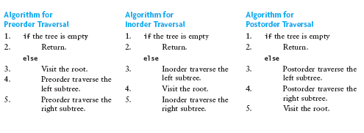
Tree Traversals (cont.)
Preorder: visit root node, traverse T_{L} , traverse T_{R}
Inorder: traverse T_{L} , visit root node, traverse T_{R}
Postorder: traverse T_{L} , traverse T_{R} , visit root node

Slide 49
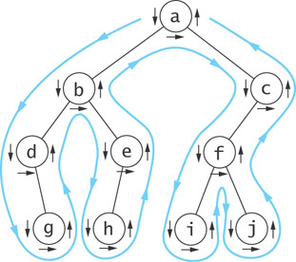
Visualizing Tree Traversals
You can visualize a tree traversal by imagining a mouse that walks along the edge of the tree
If the mouse always keeps the tree to the left, it will trace a route known as the Euler tour
The Euler tour is the path traced in blue in the figure on the right

Slide 50
Visualizing Tree Traversals (cont.)
A Euler tour (blue path) is a preorder traversal
The sequence in this example is a b d g e h c f i j
The mouse visits each node before traversing its subtrees (shown by the downward pointing arrows)

Slide 51
Visualizing Tree Traversals (cont.)
If we record a node as the mouse returns from traversing its left subtree (shown by horizontal black arrows in the figure) we get an inorder traversal
The sequence is d g b h e a i f j c

Slide 52
Visualizing Tree Traversals (cont.)
If we record each node as the mouse last encounters it, we get a postorder traversal (shown by the upward pointing arrows)
The sequence is g d h e b i j f c a

Slide 53
Traversals of Binary Search Trees and Expression Trees
An inorder traversal of a binary search tree results in the nodes being visited in sequence by increasing data value
canine, cat, dog, wolf
dog
cat
wolf
canine

Slide 54
Traversals of Binary Search Trees and Expression Trees (cont.)
An inorder traversal of an expression tree results in the sequence x + y * a + b / c
If we insert parentheses where they belong, we get the infix form:
(x + y) * ((a + b) / c)
*
+
/
x
y
+
c
a
b

Slide 55
Traversals of Binary Search Trees and Expression Trees (cont.)
A postorder traversal of an expression tree results in the sequence x y + a b + c / *
This is the postfix or reverse polish form of the expression
Operators follow operands
*
+
/
x
y
+
c
a
b

Slide 56
Traversals of Binary Search Trees and Expression Trees (cont.)
A preorder traversal of an expression tree results in the sequence * + x y / + a b c
This is the prefix form of the expression
Operators precede operands
*
+
/
x
y
+
c
a
b

Slide 57
Implementing a Binary_Tree Class
Section 8.3

Slide 58
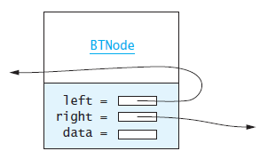
The BTNode Class
Like a linked list, a node consists of a data part and links to successor nodes
So that we can store any kind of data in a tree node, we make the data part an object of type Item_Type
A binary tree node must have links (pointers) to both its left and right subtrees

Slide 59
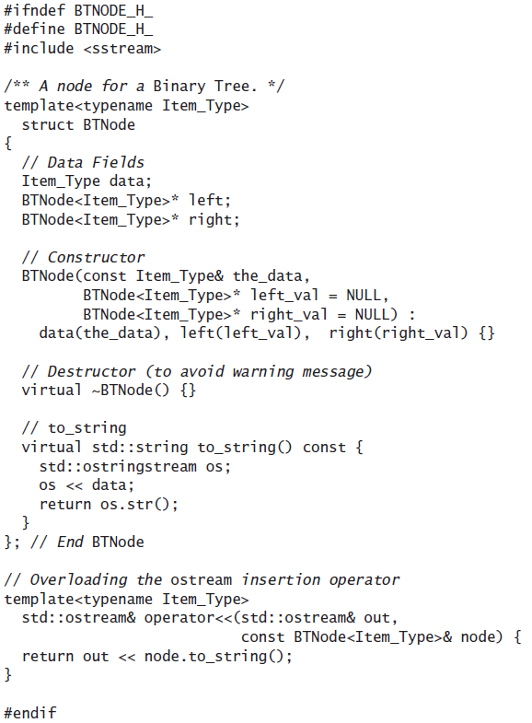
The BTNode Class (cont.)

Slide 60
Binary_Tree Class

Slide 61
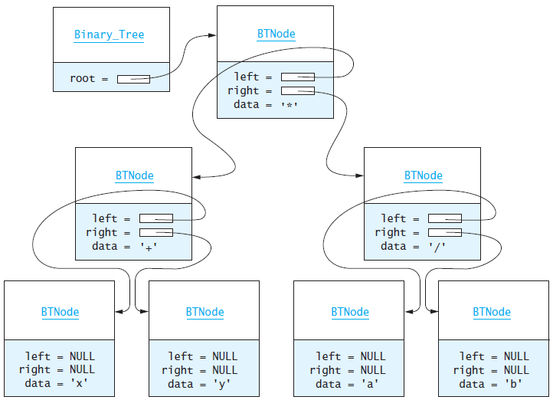
Binary_Tree Class (cont.)
bT.root->left points to the left subtree of the root (the root node of tree x + y).

Slide 62
Binary_Tree Class (cont.)
bT.root.right points to the right subtree of the root (the root node of tree a / b)

Slide 63
Binary_Tree Class (cont.)
bT.root->right.data contains the char object '/'

Slide 64
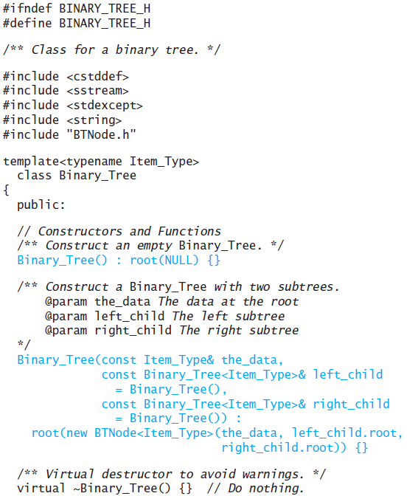
Binary_Tree Class (cont.)

Slide 65
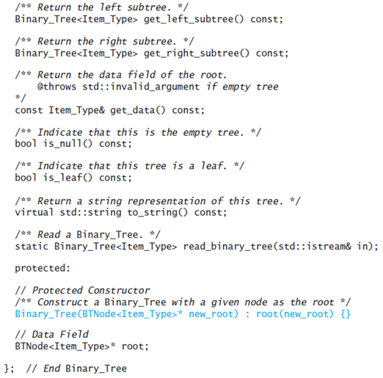
Binary_Tree Class (cont.)

Slide 66
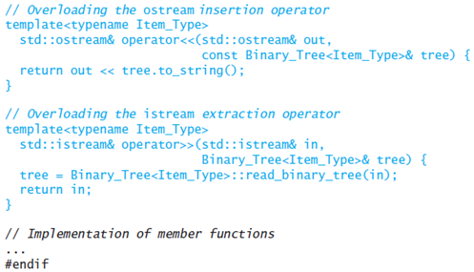
Binary_Tree Class (cont.)

Slide 67
The Constructors
There are three constructors
The no-parameter constructor:
Binary_Tree() : root(NULL) {}
The constructor that creates a tree with a given node at the root (this is a protected constructor because client classes do not know about the BTNode class):
Binary_Tree(BTNode<Item_Type>* new_root) : root(new_root) {}

Slide 68
The Constructors (cont.)
The constructor that builds a tree from a data value and two trees that will become the left and right subtrees:
Binary_Tree(const Item_Type& the_data,
const Binary_Tree<Item_Type>& left_child
= Binary_Tree(),
const Binary_Tree<Item_Type>& right_child
= Binary_Tree()):
root(new BTNode<Item_Type>(the_data, left_child.root,
right_child.root)) {}

Slide 69
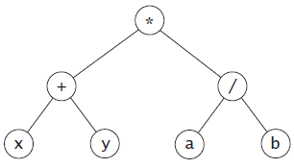
The Constructors (cont.)
If lT and rT are type Binary_Tree<char>
and lT.root points to the root node of binary tree x + y
and rT.root points to the root node of binary tree a / b
the statement
Binary_Tree<char> bT('*', lT, rT);
causes bT to contain the following tree:

Slide 70
get_left_subtree and get_right_subtree Functions
The get_left_subtree function returns a binary tree whose root is the left subtree of the object on which the function is called
It uses the protected constructor just discussed to construct a new Binary_Tree object whose root references the left subtree of this tree
/** Return the left-subtree. */
template<typename Item_Type>
Binary_Tree<Item_Type>
Binary_Tree<Item_Type>::get_left_subtree() const {
if (root == NULL) {
throw std::invalid_argument("get_left_subtree on empty tree");
}
return Binary_Tree<Item_Type>(root->left);
}
The get_right_subtree function is symmetric

Slide 71
The is_leaf Function
/** Indicate that this tree is a leaf */
template<typename Item_Type>
bool Binary_Tree<Item_Type>::is_leaf() const {
if (root != NULL) {
return root->left == NULL && root->right == NULL;
} else
return true;
}

Slide 72
The to_string Function
The to_string method generates a string representing a preorder traversal in which each local root is on a separate line
If a subtree is empty, the string "NULL" is displayed

Slide 73
The to_string Function (cont.)
*
+
x
NULL
NULL
y
NULL
NULL
/
a
NULL
NULL
b
NULL
NULL
*
+
/
x
y
a
b
(x + y) * (a / b)

Slide 74
The to_string Function (cont.)
/** Return a string representation of this tree */
template<typename Item_Type>
std::string Binary_Tree<Item_Type>::to_string() const {
std::ostringstream os;
if (is_null())
os << "NULL\n";
else {
os << *root << '\n';
os << get_left_subtree().to_string();
os << get_right_subtree().to_string();
}
return os.str();
}

Slide 75
Reading a Binary Tree
If we use an istream to read the individual lines created by the to_string function, we can reconstruct the tree using:
Read a line that represents information at the root
if it is “NULL"
Return an empty tree
else
Convert the input line to a data value
Recursively read the left child
Recursively read the right child
Return a tree consisting of the root and the two children

Slide 76
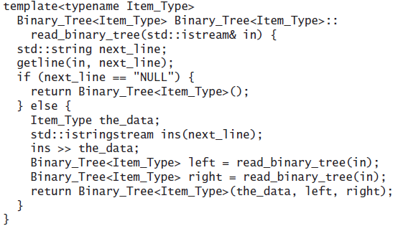
Reading a Binary Tree (cont.)

Slide 77
Using istream and ostream
We can overload the istream extraction operator for the Binary_Tree class to call the read_binary_tree function and we can overload the ostream insertion operator to call the to_string function
By doing this, we can read and write Binary_Tree objects in the same manner as we read and write other objects
// Overloading the ostream insertion operator
template<typename Item_Type>
std::ostream& operator<<(std::ostream& out,
const Binary_Tree<Item_Type>& tree) {
return out << tree.to_string();
}

Slide 78
Using istream and ostream (cont.)
// Overloading the istream extraction operator
template<typename Item_Type>
std::istream& operator>>(std::istream& in,
Binary_Tree<Item_Type>& tree) {
return in;
}

Slide 79
Copy Constructor, Assignment, and Destructor
We do not provide copy constructors, assignment operators, or functioning destructors for the Binary_Tree and BTNode classes
The purpose of these classes is to illustrate the binary tree ADT and not to provide a robust implementation

Slide 80
Copy Constructor, Assignment, and Destructor (cont.)
The constructor
Binary_Tree(const Item_Type& the_data,
const Binary_Tree<Item_Type>& left_child,
const Binary_Tree<Item_Type>& right_child)
and the functions get_left_subtree and get_right_subtree can result in multiple Binary_Tree objects containing pointers either directly or indirectly to a given BTNode object

Slide 81
Copy Constructor, Assignment, and Destructor (cont.)
One solution causes this constructor and these functions to make a copy of the subtree arguments
Then the Binary_Tree destructor can call the root’s BTNode destructor, which then recursively calls the destructors for all of the nodes in the tree
There are many cases where this is very inefficient
Thus, we have decided to live with potential memory leaks for these classes

Slide 82
Copy Constructor, Assignment, and Destructor (cont.)
An alternative is to use what is known as a smart pointer for the pointers in the BTNode and Binary_Tree classes
A smart pointer is a class that acts like a pointer, but automatically deletes the object pointed to when the pointed-to object has no owners
The text describes smart pointers in more detail in Appendix A.

Slide 83
Binary Search Trees
Section 8.4

Slide 84
Overview of a Binary Search Tree
Recall the definition of a binary search tree:
A set of nodes T is a binary search tree if either of the following is true
T is empty
If T is not empty, its root node has 0, 1, or 2 nonempty subtrees. Its left subtree, T_{L} , is a binary search tree that contains all values less than the value in the root of T; its right subtree, T_{R} , is a binary search tree that contains all values greater than the value in the root of T
We will assume that all entries saved in a binary search tree are unique (no duplicates)

Slide 85
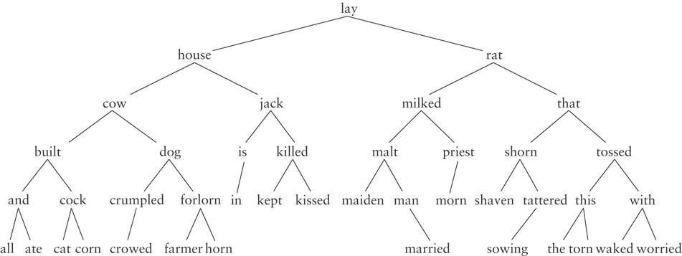
Overview of a Binary Search Tree (cont.)

Slide 86
Recursive Algorithm for Searching a Binary Search Tree
if the root is NULL
The item is not in the tree; return NULL
Compare the value of target with root->data
if they are equal
The target has been found, return the data at the root
else if the target is less than root->data
Return the result of searching the left subtree
else
Return the result of searching the right subtree

Slide 87
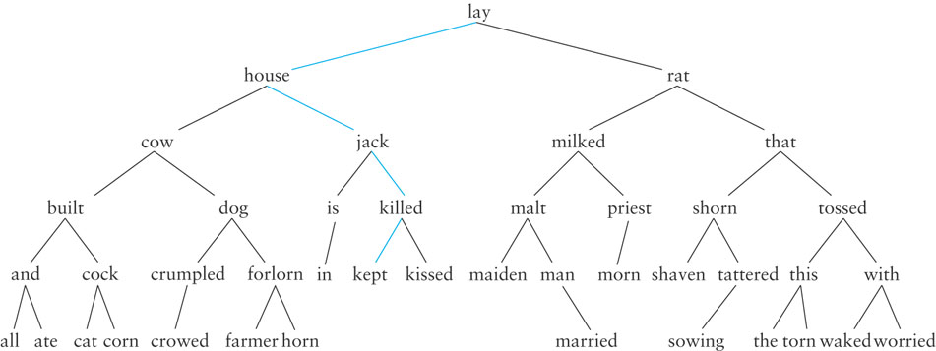
Searching a Binary Tree
Looking for jill

Slide 88
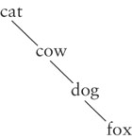
Performance
Search a tree is generally O(log n)
If a tree is not very full, performance will be worse
Searching a tree with only right subtrees, for example, is O(n)

Slide 89
The Binary_Search_Tree Class

Slide 90
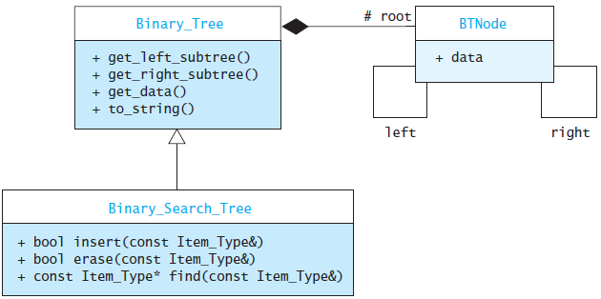
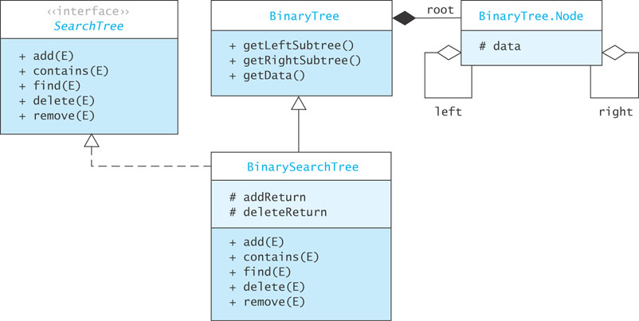
The Binary_Search_Tree Class (cont.)

Slide 91
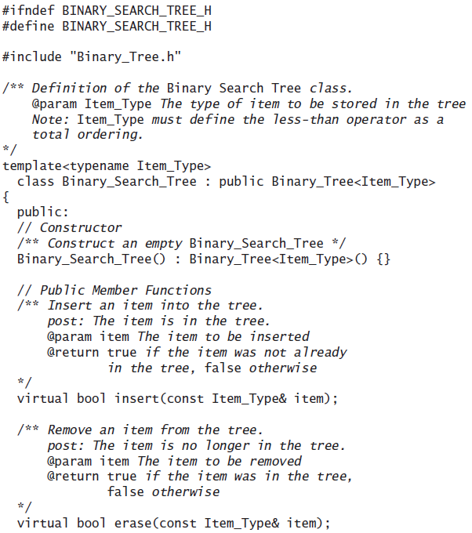
The Binary_Search_Tree Class (cont.)

Slide 92
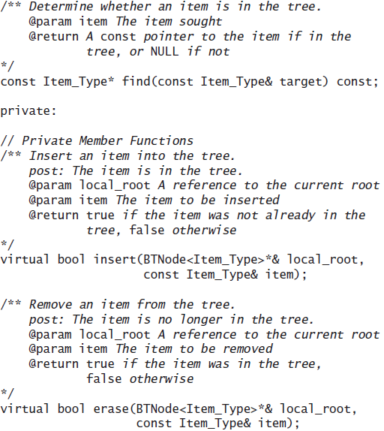
Implementing the find Functions

Slide 93
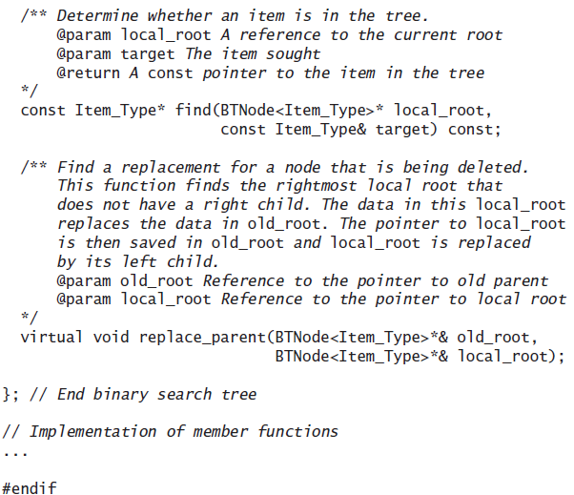
Implementing the find Functions

Slide 94
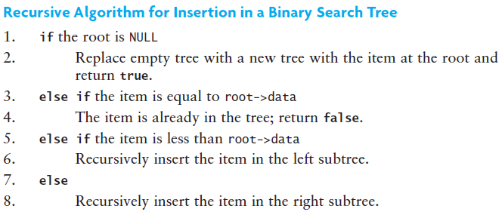
Insertion into a Binary Search Tree

Slide 95
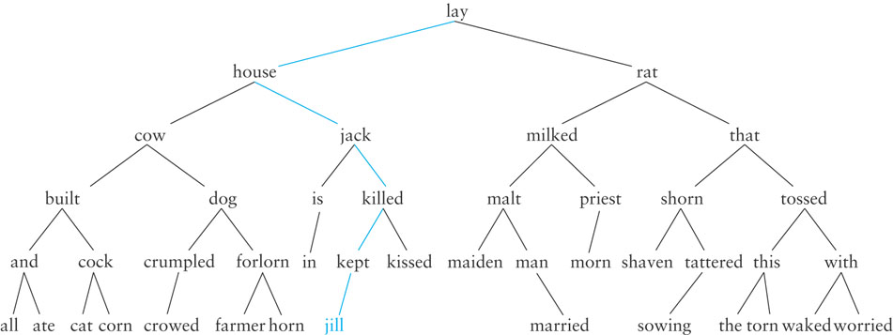
Insertion into a Binary Search Tree (cont.)
Insert jill

Slide 96
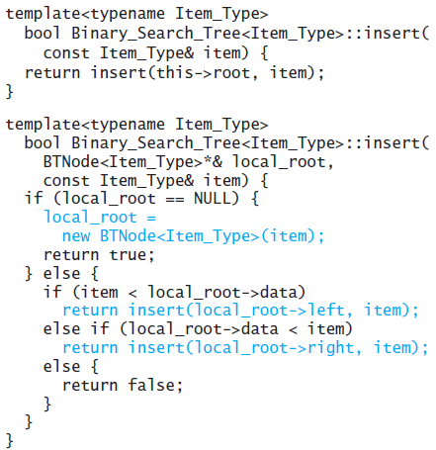
Implementing the insert Functions

Slide 97
Removal from a Binary Search Tree
If the item to be removed is a leaf node, then its parent’s reference to it is set to NULL
If the item to be removed has only one child, then the grandparent references the remaining child instead of the child’s parent (the node we want to remove)

Slide 98
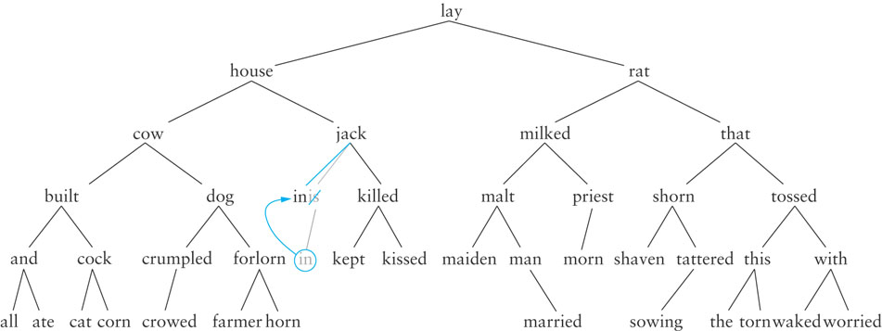
Removal from a Binary Search Tree (cont.)
Remove is

Slide 99
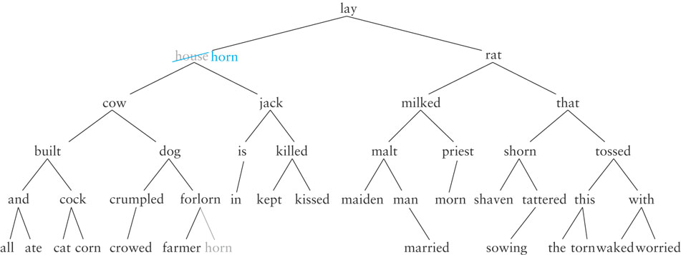
Removing from a Binary Search Tree (cont.)
If the item to be removed has two children, replace it with the largest item in its left subtree – it inorder predecessor
Remove house

Slide 100
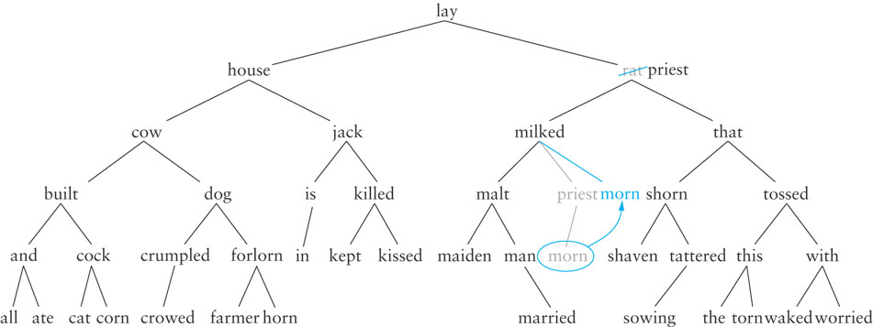
Removing from a Binary Search Tree (cont.)
Remove rat

Slide 101
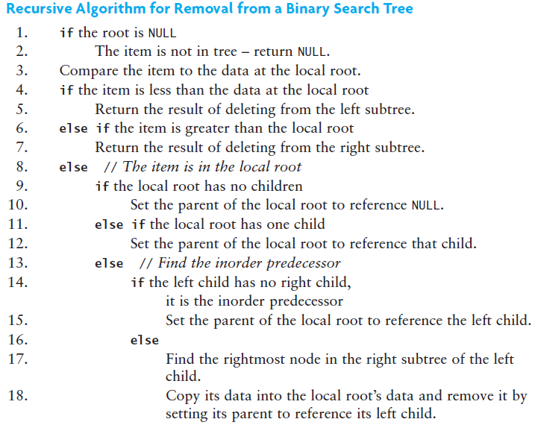
Recursive Algorithm for Removal from a Binary Search Tree

Slide 102
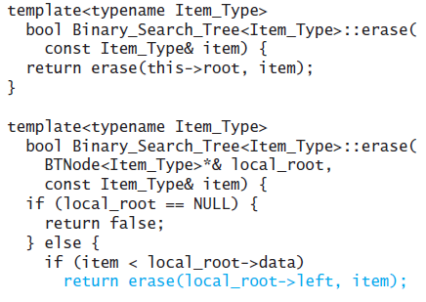
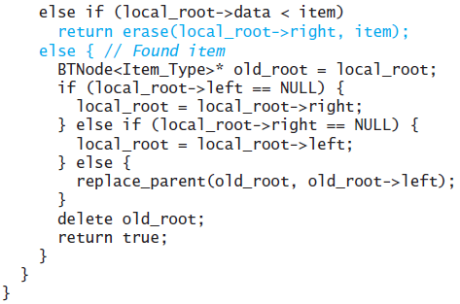
Implementing the erase Functions

Slide 103
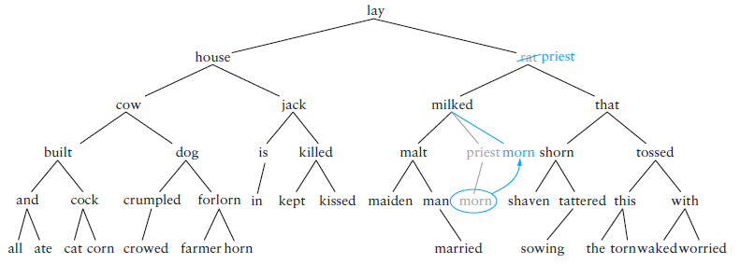
The replace_parent Function

Slide 104
The replace_parent Function (cont.)

Slide 105
The replace_parent Function (cont.)
(in the preceding figure)
Recursion stops with old_root pointing to the node with the value to be removed (rat)
The left child (milked) of the node to be deleted (rat) has a right child (priest) which is its largest child
local_root references the node priest
old_node-> data will contain priest, replacing rat
old_root is changed to point to priest
node morn (the left child of priest becomes the new right child of milked)

Slide 106
Testing a Binary Search Tree
To test a binary search tree, verify that an inorder traversal displays the tree contents in ascending order after a series of insertions and deletions are performed

Slide 107
Writing an Index for a Term Paper
Problem: write an index for a term paper
The index should show each word in the paper followed by the line number on which it occurred
The words should be displayed in alphabetical order
If a word occurs on multiple lines, the line numbers should be listed in ascending order:
a, 3 a, 13 are, 3

Slide 108
Writing an Index for a Term Paper (cont.)
Analysis
Store each word and its line number as a string in a tree node
Two occurences of "C++" on lines 5 and 10 could be stored as the strings "c++, 5" and "c++, 10"
Each word will be stored in lowercase to ensure that it appears in its proper position in the index
The line number is right-justified so that the string "c++, 5" is considered less than the string "c++, 10"
If the leading spaces were removed, this would not be the case ("c++, 5" is greater than "c++, 10")

Slide 109
Writing an Index for a Term Paper (cont.)
Analysis (cont.)
After all the strings are stored in the search tree, we can display them in ascending order by performing an inorder traversal
Storing each word in a search tree is an O(log n) process, where n is the number of words currently in the tree
Storing each word in an ordered list is an O(n) process.

Slide 110
Writing an Index for a Term Paper (cont.)
Design
We will use the Binary_Search_Tree just discussed to store the index
Function build_index will read each word from a data file and store it in the search tree
Function print_index will display the index

Slide 111
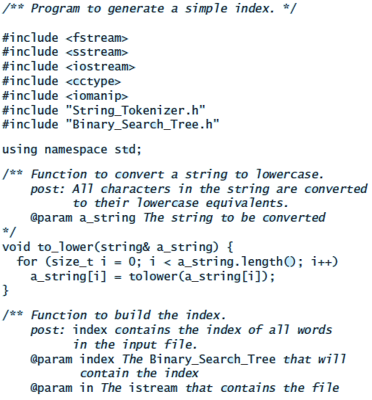
Writing an Index for a Term Paper (cont.)

Slide 112
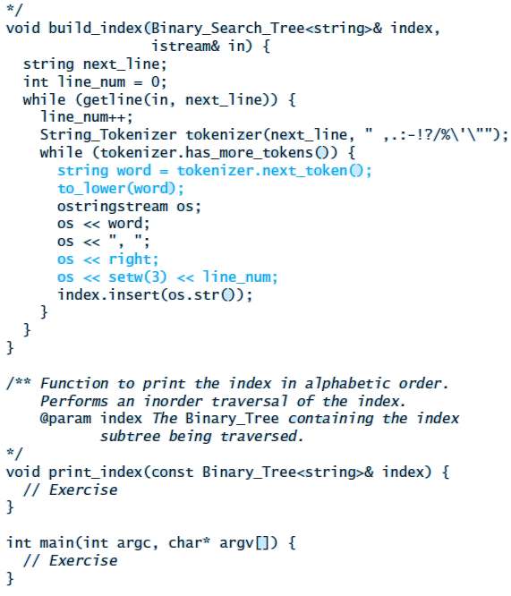
Writing an Index for a Term Paper (cont.)

Slide 113
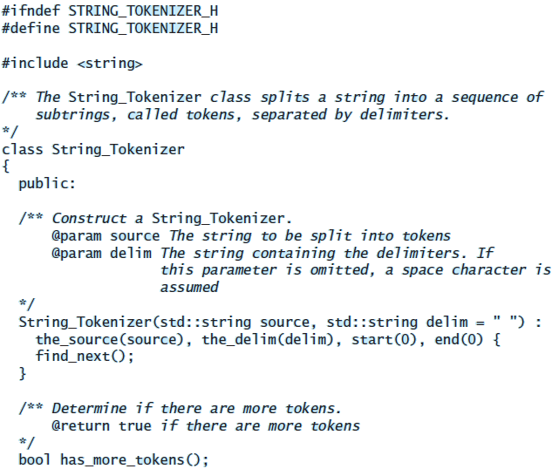
Writing an Index for a Term Paper (cont.)

Slide 114
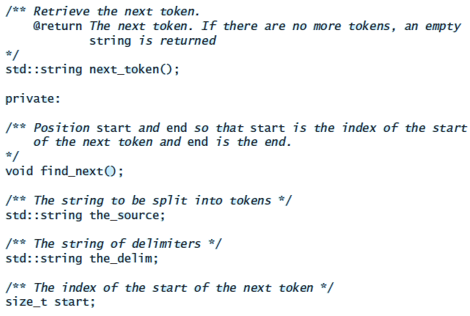
Writing an Index for a Term Paper (cont.)

Slide 115
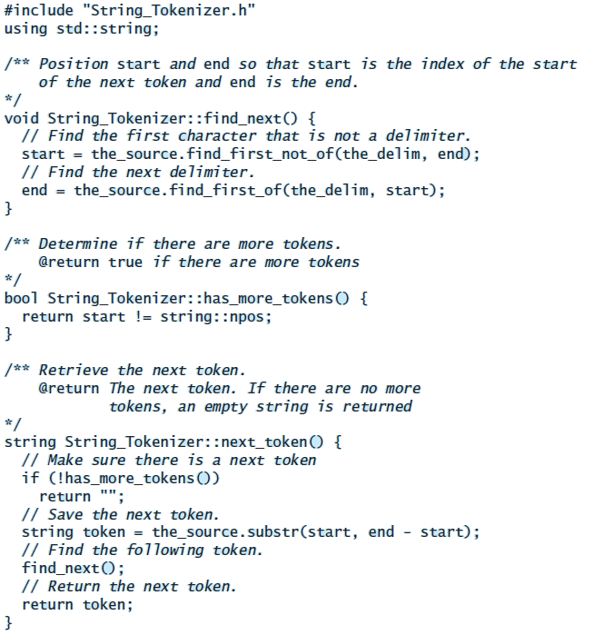
Writing an Index for a Term Paper (cont.)

Slide 116
Writing an Index for a Term Paper (cont.)
Testing
Write a main function that declares new ifstream and Binary_Tree<string> objects. The ifstream can reference any text file stored on your hard drive
Make sure that
duplicate words are handled properly (including duplicates on the same line)
words at the end of each line are stored in the index
empty lines are processed correctly
the last line of the document is also part of the index

Slide 117
Heaps and Priority Queues
Section 8.5

Slide 118
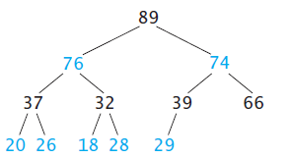
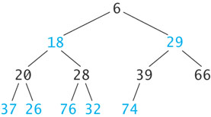
Heaps and Priority Queues
A heap is a complete binary tree where the value in each node is greater than or equal to all values in the node’s subtrees

Slide 119
Heaps and Priority Queues (cont.)
The heap shown below is called a min heap because the root node stores a smallest value
It is also possible to build and use a max heap, in which each node’s value is larger than or equal to the values of its children, and the root node stores the largest value

Slide 120
Heaps and Priority Queues (cont.)
The text presents algorithms and illustrations for max heaps
Here we present the corresponding algorithms and illustrations for min heaps

Slide 121
Heaps and Priority Queues (cont.)
A heap is a complete binary tree with the following properties:
The value in the root is less than or equal to all items in the tree.
Every subtree is a heap

Slide 122
Inserting an Item into a Min Heap
6
18
29
20
28
39
66
37
26
76
32
74
89

Slide 123
Inserting an Item into a Min Heap (cont.)
6
18
29
20
28
39
66
37
26
76
32
74
89
8

Slide 124
Inserting an Item into a Min Heap (cont.)
6
18
29
20
28
39
8
37
26
76
32
74
89
66

Slide 125
Inserting an Item into a Min Heap (cont.)
6
18
8
20
28
39
29
37
26
76
32
74
89
66

Slide 126
Inserting an Item into a Min Heap (cont.)
6
18
8
20
28
39
29
37
26
76
32
74
89
66

Slide 127
Inserting an Item into a Min Heap (cont.)
6
18
8
20
28
39
29
37
26
76
32
74
89
66

Slide 128
Removing an Item from a Heap
6
18
8
20
28
39
29
37
26
76
32
74
89
66

Slide 129
Removing an Item from a Heap (cont.)
66
18
8
20
28
39
29
37
26
76
32
74
89

Slide 130
Removing an Item from a Heap (cont.)
8
18
66
20
28
39
29
37
26
76
32
74
89

Slide 131
Removing an Item from a Heap (cont.)
8
18
29
20
28
39
66
37
26
76
32
74
89

Slide 132
Removing an Item from a Heap (cont.)
8
18
29
20
28
39
66
37
26
76
32
74
89

Slide 133
Implementing a Min Heap
Because a heap is a complete binary tree, it can be implemented efficiently using an array rather than a linked data structure

Slide 134
Implementing a Min Heap (cont.)
8
8
29
18
29
18
39
66
20
66
20
28
28
39
37
37
26
26
76
76
32
32
74
74
89
89
0
1
2
3
4
5
6
7
8
9
10
11
12
8
18
29
20
28
39
66
37
26
76
32
74
89

Slide 135
Implementing a Min Heap (cont.)
For a node at position p, L. child position: 2p + 1
R. child position: 2p + 2
8
18
29
20
28
39
66
37
26
76
32
74
89
0
1
2
3
4
5
6
7
8
9
10
11
12
8
18
29
20
28
39
66
37
26
76
32
74
89
Parent
L. Child
R. Child

Slide 136
Implementing a Min Heap (cont.)
For a node at position p, L. child position: 2p + 1
R. child position: 2p + 2
8
18
29
20
28
39
66
37
26
76
32
74
89
0
1
2
3
4
5
6
7
8
9
10
11
12
8
18
29
20
28
39
66
37
26
76
32
74
89
Parent
L. Child
R. Child

Slide 137
Implementing a Min Heap (cont.)
For a node at position p, L. child position: 2p + 1
R. child position: 2p + 2
8
18
29
20
28
39
66
37
26
76
32
74
89
0
1
2
3
4
5
6
7
8
9
10
11
12
8
18
29
20
28
39
66
37
26
76
32
74
89
Parent
L. Child
R. Child

Slide 138
Implementing a Min Heap (cont.)
For a node at position p, L. child position: 2p + 1
R. child position: 2p + 2
8
18
29
20
28
39
66
37
26
76
32
74
89
0
1
2
3
4
5
6
7
8
9
10
11
12
8
18
29
20
28
39
66
37
26
76
32
74
89
Parent
L. Child
R. Child

Slide 139
Implementing a Min Heap (cont.)
For a node at position p, L. child position: 2p + 1
R. child position: 2p + 2
8
18
29
20
28
39
66
37
26
76
32
74
89
0
1
2
3
4
5
6
7
8
9
10
11
12
8
18
29
20
28
39
66
37
26
76
32
74
89
Parent
L. Child
R. Child

Slide 140
Implementing a Min Heap (cont.)
8
18
29
A node at position c can find its parent at (c – 1)/2
20
28
39
66
37
26
76
32
74
89
0
1
2
3
4
5
6
7
8
9
10
11
12
8
18
29
20
28
39
66
37
26
76
32
74
89
Parent
Child

Slide 141
Inserting into a Min Heap Implemented as a Vector
1. Insert the new element at the end of the vector and set child to table.size() - 1
8
18
29
20
28
39
66
37
26
76
32
74
89
0
1
2
3
4
5
6
7
8
9
10
11
12
13
8
18
29
20
28
39
66
37
26
76
32
74
89

Slide 142
Inserting into a Min Heap Implemented as a Vector (cont.)
1. Insert the new element at the end of the vector and set child to table.size() - 1
6
18
29
20
28
39
66
37
26
76
32
74
89
8
0
1
2
3
4
5
6
7
8
9
10
11
12
13
6
18
29
20
28
39
66
37
26
76
32
74
89
8
Child

Slide 143
Inserting into a Min Heap Implemented as a Vector (cont.)
2. Set parent to (child – 1)/ 2
6
18
29
20
28
39
66
37
26
76
32
74
89
8
0
1
2
3
4
5
6
7
8
9
10
11
12
13
6
18
29
20
28
39
66
37
26
76
32
74
89
8
Parent
Child

Slide 144
Inserting into a Min Heap Implemented as a Vector (cont.)
3. while (parent >= 0 and table[parent] > table[child])
Swap table[parent] and table[child]
Set child equal to parent
Set parent equal to (child-1)/2
6
18
29
20
28
39
66
37
26
76
32
74
89
8
0
1
2
3
4
5
6
7
8
9
10
11
12
13
6
18
29
20
28
39
66
37
26
76
32
74
89
8
Parent
Child

Slide 145
Inserting into a Min Heap Implemented as a Vector (cont.)
3. while (parent >= 0 and table[parent] > table[child])
Swap table[parent] and table[child]
Set child equal to parent
Set parent equal to (child-1)/2
6
18
29
20
28
39
8
37
26
76
32
74
89
66
0
1
2
3
4
5
6
7
8
9
10
11
12
13
6
18
29
20
28
39
8
37
26
76
32
74
89
66
Parent
Child

Slide 146
Inserting into a Min Heap Implemented as a Vector (cont.)
3. while (parent >= 0 and table[parent] > table[child])
Swap table[parent] and table[child]
Set child equal to parent
Set parent equal to (child-1)/2
6
18
29
20
28
39
8
37
26
76
32
74
89
66
0
1
2
3
4
5
6
7
8
9
10
11
12
13
6
18
29
20
28
39
8
37
26
76
32
74
89
66
Parent
Child

Slide 147
Inserting into a Min Heap Implemented as a Vector (cont.)
3. while (parent >= 0 and table[parent] > table[child])
Swap table[parent] and table[child]
Set child equal to parent
Set parent equal to (child-1)/2
6
18
29
20
28
39
8
37
26
76
32
74
89
66
0
1
2
3
4
5
6
7
8
9
10
11
12
13
6
18
29
20
28
39
8
37
26
76
32
74
89
66
Parent
Child

Slide 148
Inserting into a Min Heap Implemented as a Vector (cont.)
3. while (parent >= 0 and table[parent] > table[child])
Swap table[parent] and table[child]
Set child equal to parent
Set parent equal to (child-1)/2
6
18
29
20
28
39
8
37
26
76
32
74
89
66
0
1
2
3
4
5
6
7
8
9
10
11
12
13
6
18
29
20
28
39
8
37
26
76
32
74
89
66
Parent
Child

Slide 149
Inserting into a Min Heap Implemented as a Vector (cont.)
3. while (parent >= 0 and table[parent] > table[child])
Swap table[parent] and table[child]
Set child equal to parent
Set parent equal to (child-1)/2
6
18
8
20
28
39
29
37
26
76
32
74
89
66
0
1
2
3
4
5
6
7
8
9
10
11
12
13
6
18
8
20
28
39
29
37
26
76
32
74
89
66
Parent
Child

Slide 150
Inserting into a Min Heap Implemented as a Vector (cont.)
3. while (parent >= 0 and table[parent] > table[child])
Swap table[parent] and table[child]
Set child equal to parent
Set parent equal to (child-1)/2
6
18
8
20
28
39
29
37
26
76
32
74
89
66
0
1
2
3
4
5
6
7
8
9
10
11
12
13
6
18
8
20
28
39
29
37
26
76
32
74
89
66
Parent
Child

Slide 151
Inserting into a Min Heap Implemented as a Vector (cont.)
3. while (parent >= 0 and table[parent] > table[child])
Swap table[parent] and table[child]
Set child equal to parent
Set parent equal to (child-1)/2
6
18
8
20
28
39
29
37
26
76
32
74
89
66
0
1
2
3
4
5
6
7
8
9
10
11
12
13
6
18
8
20
28
39
29
37
26
76
32
74
89
66
Parent
Child

Slide 152
Inserting into a Min Heap Implemented as a Vector (cont.)
3. while (parent >= 0 and table[parent] > table[child])
Swap table[parent] and table[child]
Set child equal to parent
Set parent equal to (child-1)/2
6
18
8
20
28
39
29
37
26
76
32
74
89
66
0
1
2
3
4
5
6
7
8
9
10
11
12
13
6
18
8
20
28
39
29
37
26
76
32
74
89
66

Slide 153
Removal from a Min Heap Implemented as a vector
1. Remove the last element (i.e., the one at size() – 1) and set the item at 0 to this value.
2. Set parent to 0.
3. while (true)
4. Set left_child to (2 * parent) + 1 and right_child to left_child + 1
5. if leftChild >= table.size()
6. Break out of loop.
7. Assume min_child (the smaller child) is left_child
8. if right_child < table.size() and
table[left_child] > table[right_child]
9. Set min_child to right_child
10. if table[parent] > table[min_child]
11. Swap table[parent] and table[min_child]
12. Set parent to min_child
else
13. Break out of loop.

Slide 154
Performance of the Heap
The removal algorithm traces a path from the root to a leaf
The insertion algorithm traces a path from a leaf to the root
This requires at most h steps where h is the height of the tree
The largest full tree of height h has 2^{h}-1 nodes
The smallest complete tree of height h has 2^{(h-1)} nodes
Both insert and remove are O(log n) where n is the number of items in the heap

Slide 155
Priority Queues
The heap is used to implement a special kind of queue called a priority queue
Sometimes a FIFO queue may not be the best way to implement a waiting line
A priority queue is a data structure in which only the highest-priority item is accessible

Slide 156
Priority Queues (cont.)
In a print queue, sometimes it is more appropriate to print a short document that arrived after a very long document
A priority queue is a data structure in which only the highest-priority item is accessible (as opposed to the first item entered)

Slide 157
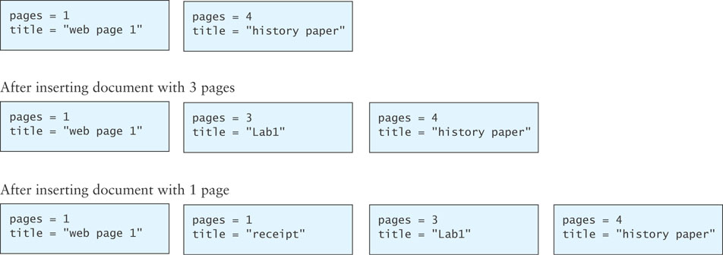
Insertion into a Priority Queue

Slide 158
priority_queue Class
C++ provides a priority_queue class that uses the same interface as the queue given in Chapter 6
The differences are in the specification for the top and pop functions—these are defined to return a largest item in the queue rather than an oldest item

Slide 159
Using a Heap as the Basis of a Priority Queue
In a priority queue, just like a heap, the largest item always is removed first
Because heap insertion and removal is O(log n), a heap can be the basis of a very efficient implementation of a priority queue
We will call our class KW::priority_queue to differentiate it from class std::priority_queue in the C++ standard library, which also uses a heap as the basis of its implementation
The interfaces for our class and the standard class are identical, but the implementations are slightly different

Slide 160
Using a Heap as the Basis of a Priority Queue (cont.)
To remove an item from the priority queue, we take the first item from the vector; this is the largest item in the max heap
We then remove the last item from the vector and put it into the first position of the vector, overwriting the value currently there
Then following the algorithm for a max heap, we move this item down until it is larger than its children or it has no children

Slide 161
Design of the KW::priority_queue Class

Slide 162
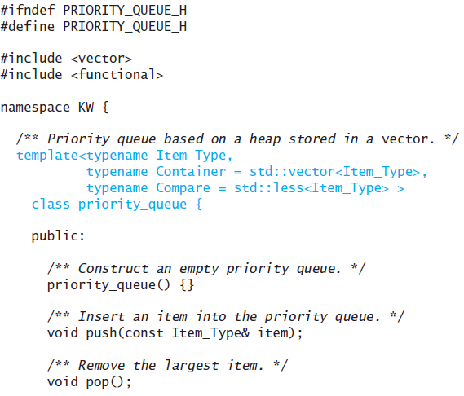
Design of the KW::priority_queue Class (cont.)

Slide 163
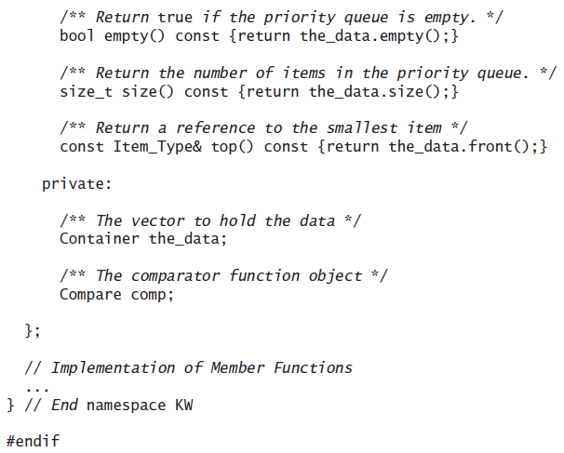
Design of the KW::priority_queue Class (cont.)

Slide 164
Specifying Defaults for a Template Class
The template class heading
template<typename Item_Type,
typename Container = std::vector<Item_Type>,
typename Compare = std::less<Item_Type> >
class priority_queue {
prescribes defaults for data types Container (default is a vector)
and Compare (default is operator less)
In an application, the declaration
priority_queue<string> pQa;
creates a priority queue pQa that uses a vector (the default) for
storage of string data and operator less (the default) for
comparisons
The declaration
priority_queue<string, deque<string> > pQb;
creates a priority queue pQb that uses a deque for storage of string
data and operator less (the default) for comparisons

Slide 165
The push Function
template<typename Item_Type, typename Container, typename Compare>
void priority_queue<Item_Type, Container, Compare>::push(
const Item_Type& item) {
the_data.push_back(item);
int child = size() - 1;
int parent = (child - 1) / 2;
// Reheap
while (parent >= 0
&& comp(the_data[parent], the_data[child])) {
std::swap(the_data[child], the_data[parent]);
child = parent;
parent = (child - 1) / 2;
}
}

Slide 166
The pop Function
template<typename Item_Type, typename Container, typename Compare>
void priority_queue<Item_Type, Container, Compare>::pop() {
if (size() == 1) {
the_data.pop_back();
return;
}
std::swap(the_data[0], the_data[size() - 1]);
the_data.pop_back();
int parent = 0;
while (true) {
int left_child = 2 * parent + 1;
if (left_child >= size())
break; // out of heap
int right_child = left_child + 1;
int max_child = left_child;

Slide 167
The pop Function (cont.)
if (right_child < size()
&& comp(the_data[left_child], the_data[right_child]))
max_child = right_child;
// assert: max_child is the index of the larger child
if (comp(the_data[parent], the_data[max_child])) {
std::swap(the_data[max_child], the_data[parent]);
parent = max_child;
}
else
break;
}
}

Slide 168
Using a Compare Function Class
When comparing elements in a priority queue, we usually insert objects that implement operator< and use their natural ordering
However, we may want to specify a different ordering from that defined by the object’s operator<
For example, files to be printed may be ordered by their name using the operator< function, but we may want to assign priority based on their length
To indicate that we want to use an ordering that is different from the natural ordering for the objects in our heap, we provide a template argument that is a function class
This function class’s operator()performs the comparison

Slide 169
Print_Document Example
The class Print_Document is used to define documents to be printed
This class implements operator<, but its operator< function performs a lexical comparison of document names; however, we want the print order to be a function of the file size and time submitted
The class has a get_size function that gives the number of bytes to be transmitted to the printer, and a get_time_stamp function that gets the time that the print job was submitted
By using a priority value that is a combination of size and time, we achieve a balanced usage of the printer

Slide 170
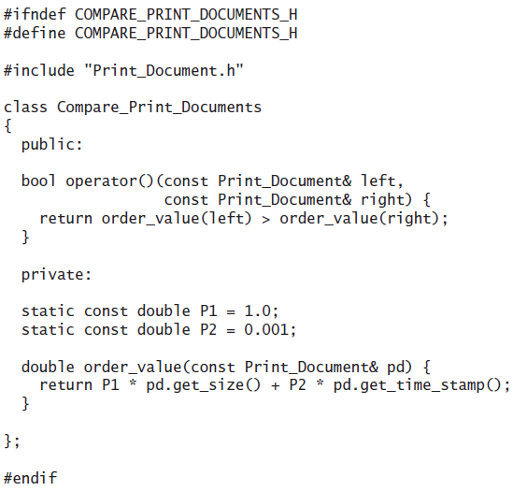
Print_Document Example (cont.)

Slide 171
Print_Document Example (cont.)
In the client program, we use
priority_queue<Print_Document,
std::vector<Print_Document>,Compare_Print_Documents>
print_queue;
to create a print queue

Slide 172
The std::less Function Class
If a Compare function class is not provided when the priority_queue is declared, the std::less class is used
This template class is defined in the header <functional> and it has a definition that is equivalent to the following:
template<typename value_type>
struct less {
bool operator()(const value_type& left,
const value_type& right) {
return left < right;
}
};

Slide 173
Huffman Trees
Section 8.6

Slide 174
Huffman Trees
A Huffman tree can be implemented using a binary tree and a priority_queue
A straight binary encoding of an alphabet assigns a unique binary number k to each symbol in the alphabet a_{k}
ASCII is an example of such a coding
ASCII has 256 possible characters
The length of a message would be 8 x n where n is the total number of character
The message “go eagles” requires 9 x 8 or 72 bits in ASCII but only 38 bits using Huffman coding

Slide 175
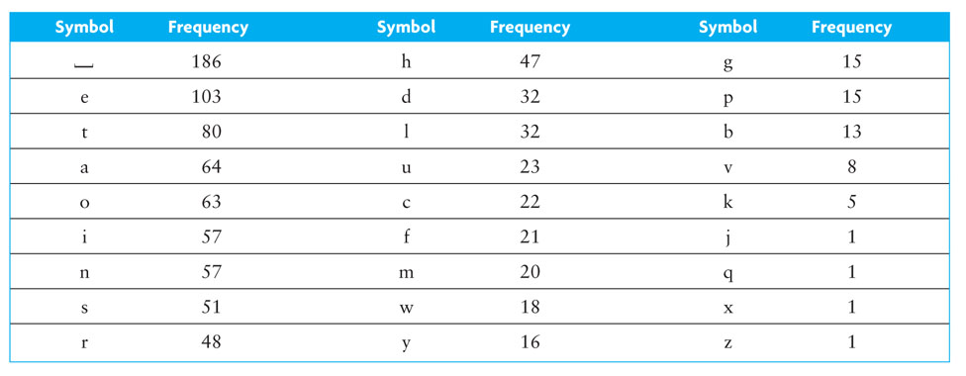
Huffman Trees (cont.)

Slide 176
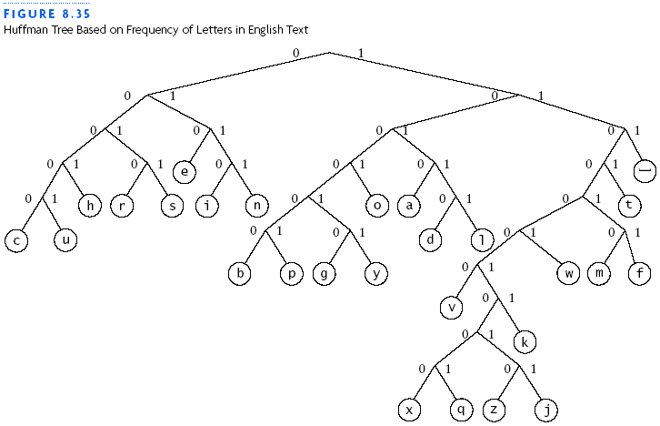
Huffman Trees (cont.)

Slide 177
Building a Custom Huffman Tree
Suppose we want to build a custom Huffman tree for a file
Input: a vector of objects such that each object contains a symbol occurring in that file and the frequency of occurrence (weight) for the symbol in that file

Slide 178
Building a Custom Huffman Tree (cont.)
Analysis:
Each node will have storage for two data items:
the weight of the node
the symbol associated with the node
All symbols will be stored in leaf nodes
For nodes that are not leaf nodes, the symbol part has no meaning
The weight of a leaf node will be the frequency of the symbol stored at that node
The weight of an interior node will be the sum of frequencies of all leaf nodes in the subtree rooted at the interior node

Slide 179
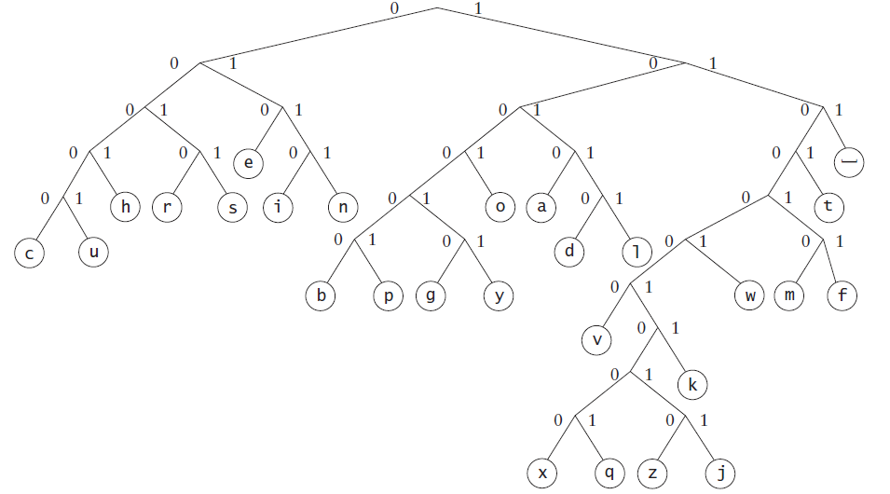
Building a Custom Huffman Tree (cont.)
Analysis:
The internal node with leaf nodes c and u (on the left), would have a weight of 45 (22 + 23)

Slide 180
Building a Custom Huffman Tree (cont.)
Analysis:
A priority queue will be the key data structure in our Huffman tree
We will store individual symbols and subtrees of multiple symbols in order by their priority (frequency of occurrence)
We want to remove symbols that occur less frequently first, because they should be lower down in the Huffman tree we are constructing

Slide 181
Building a Custom Huffman Tree (cont.)
Analysis:
To build a Huffman tree, we start by inserting trees with just leaf nodes in a priority queue
Each leaf node will store a symbol and its weight
The queue elements will be ordered so that the leaf node with smallest weight (lowest frequency) is removed first
To represent the tree referenced by a queue element, we list the root node information for that tree
The queue elements are shown in priority order

Slide 182
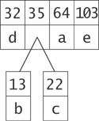
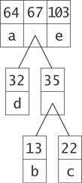
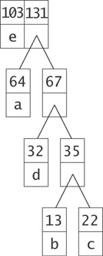
Building a Custom Huffman Tree (cont.)

Slide 183
Building a Custom Huffman Tree (cont.)

Slide 184
Design

Slide 185
Design (cont.)
Algorithm for Building a Huffman Tree
1. Construct a set of trees with root nodes that contain each of the individual symbols and their weights.
2. Place the set of trees into a priority queue
3. while the priority queue has more than one item
4. Remove the two trees with the smallest weights
5. Combine them into a new binary tree in which the weight of the tree root is the sum of the weights of its children
6. Insert the newly created tree back into the priority queue

Slide 186
Implementation

Slide 187
Implementation (cont.)

Slide 188
Testing

Slide 189
Testing (cont.)

